Slide 1
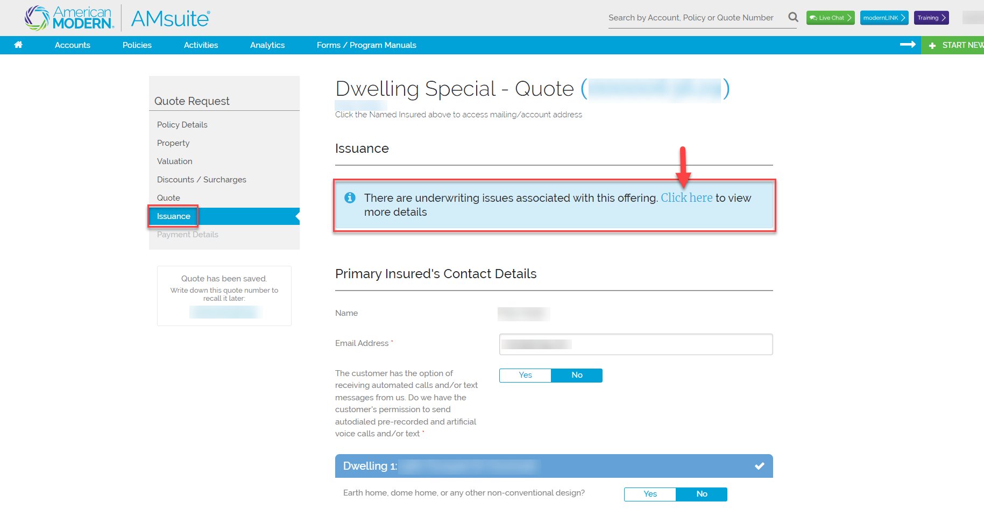
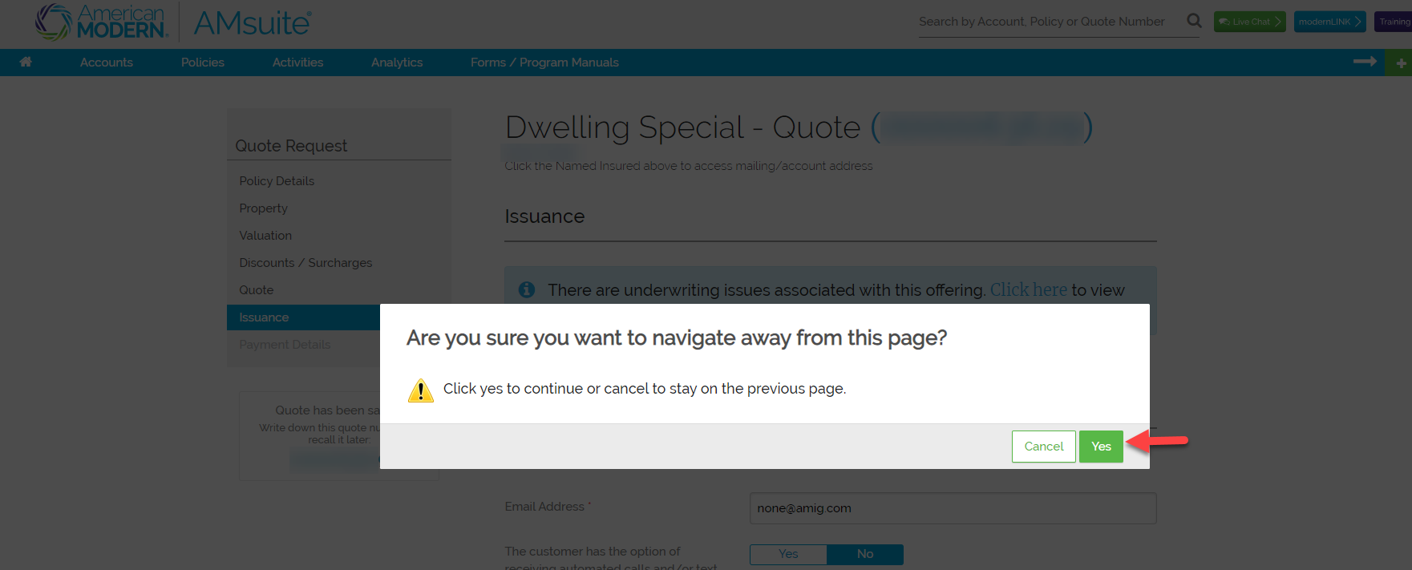
Underwriting Referral Process
When quoting a risk, an underwriting rule that requires further review could be encountered. On the Issuance page a blue message that allows you to view more details will appear
Select Click Here to view
1
2
A message will appear “Are you sure you want to navigate away from this page?” Select Yes
3
For Agent Use Only - Not for Distribution .
September 2024
Version: #2

Slide 2
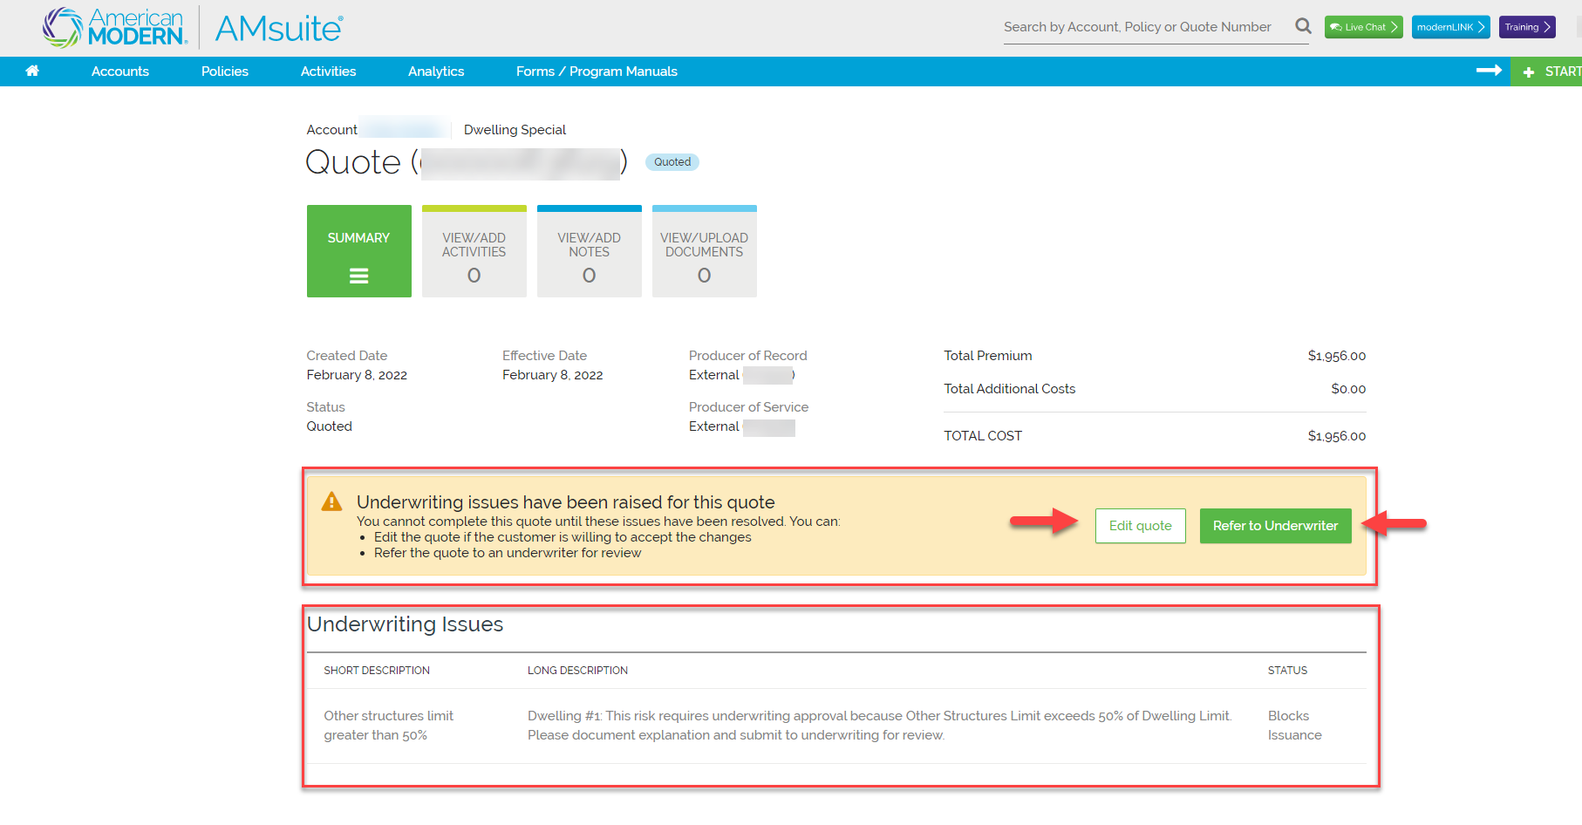
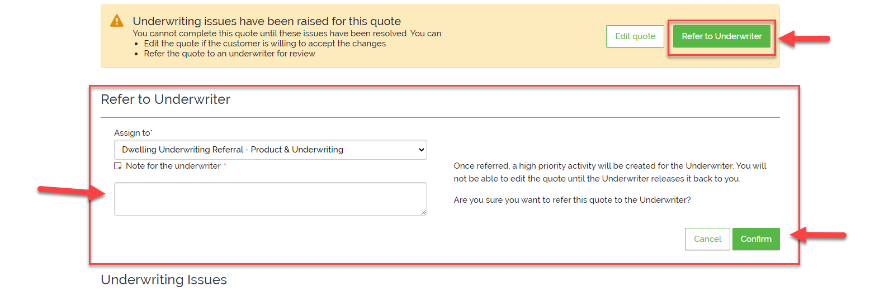
Underwriting Referral Process
A box will show Underwriting issues have been raised for this quote the Underwriting Issues are shown below
You can either Edit the quote to make it within the state specific guidelines or refer to Underwriting for further review
4
5
6
When Refer to Underwriting is selected a box will open, place the request for an exception to the rule here. Noting as much detail as possible to assist the Underwriting Authority with their decision. Assign to will default to your Underwriting Authority. Select confirm to submit for review
For Agent Use Only - Not for Distribution .
September 2024
Version: #2

Slide 3
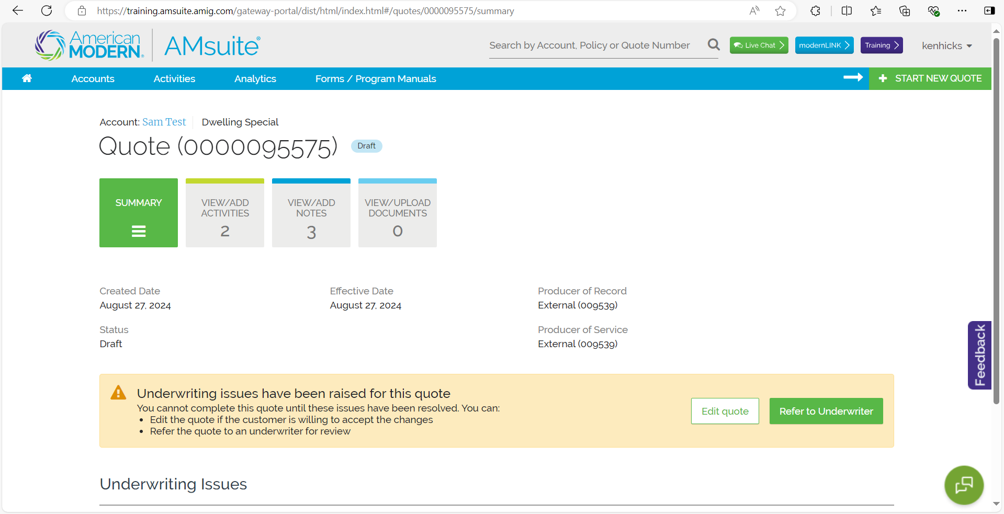
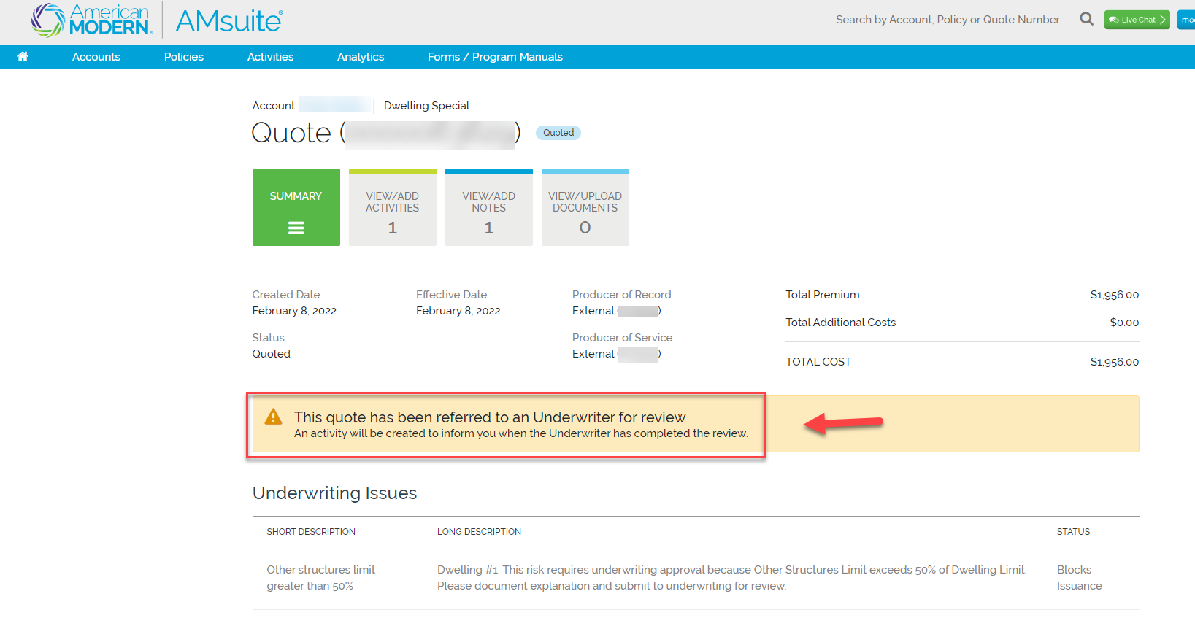
Underwriting Referral Process
7
If the Underwriter requires additional information for consideration, the quote will remain unbound until you provide the requested information. Once the information has been received, the quote must be referred back to the Underwriter. The Underwriter will not receive the activity until Refer to Underwriter is selected.
For Agent Use Only - Not for Distribution .
September 2024
Version: #2

Slide 4
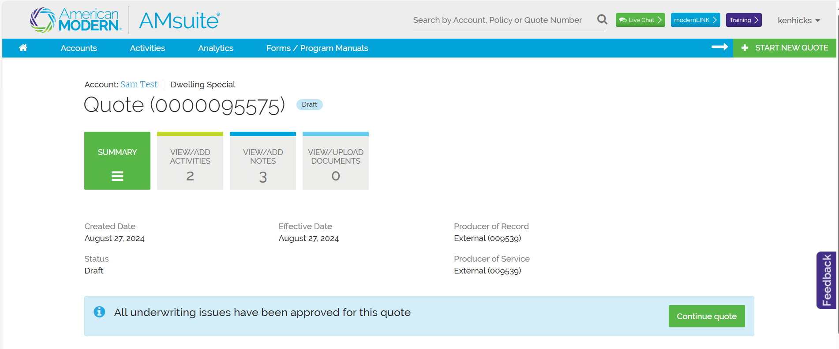
Underwriting Referral Process
8
Once submitted a message will appear that the risk has been referred to Underwriting for review. At this point, the quote can be closed. A response from Underwriting will be received within five business days (8 PM EST) via Activity
9
Once Underwriting has reviewed the referral, the Underwriter will respond via Activity. If the exception request is approved, please select continue quote and proceed to issuance.
For Agent Use Only - Not for Distribution .
September 2024
Version: #2

Slide 5
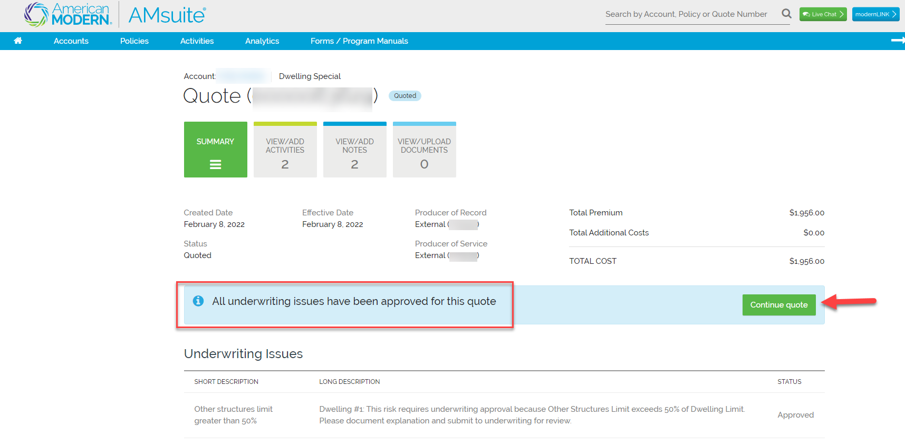
Underwriting Referral Process
Activity Email
From: AMIG Activity Notification <noreply-activity@amig.com> Subject: American Modern AMsuite Activity for Policy xxx requires action - "Underwriter has reviewed this job"
Your action is required by 02/16/2022. An AMsuite Activity "Underwriter has reviewed this job" has been assigned to you for a policy or submission belonging to applicant. Please log into American Modern AMsuite via modernLINK to review the complete description and take the appropriate follow up action(s) by 02/16/2022. This email is an automated notification. Please do not reply.
Completing and Binding the Quote
If the Underwriting authority has approved the request for an exception, you will need to apply payment to finish the quote. From the Summary page you will see a blue box that has the message that All Underwriting Issues have been approved for this quote.
Select Continue to complete the Quote, apply the payment to bind
10
11
For Agent Use Only - Not for Distribution .
September 2024
Version: #2

Slide 6
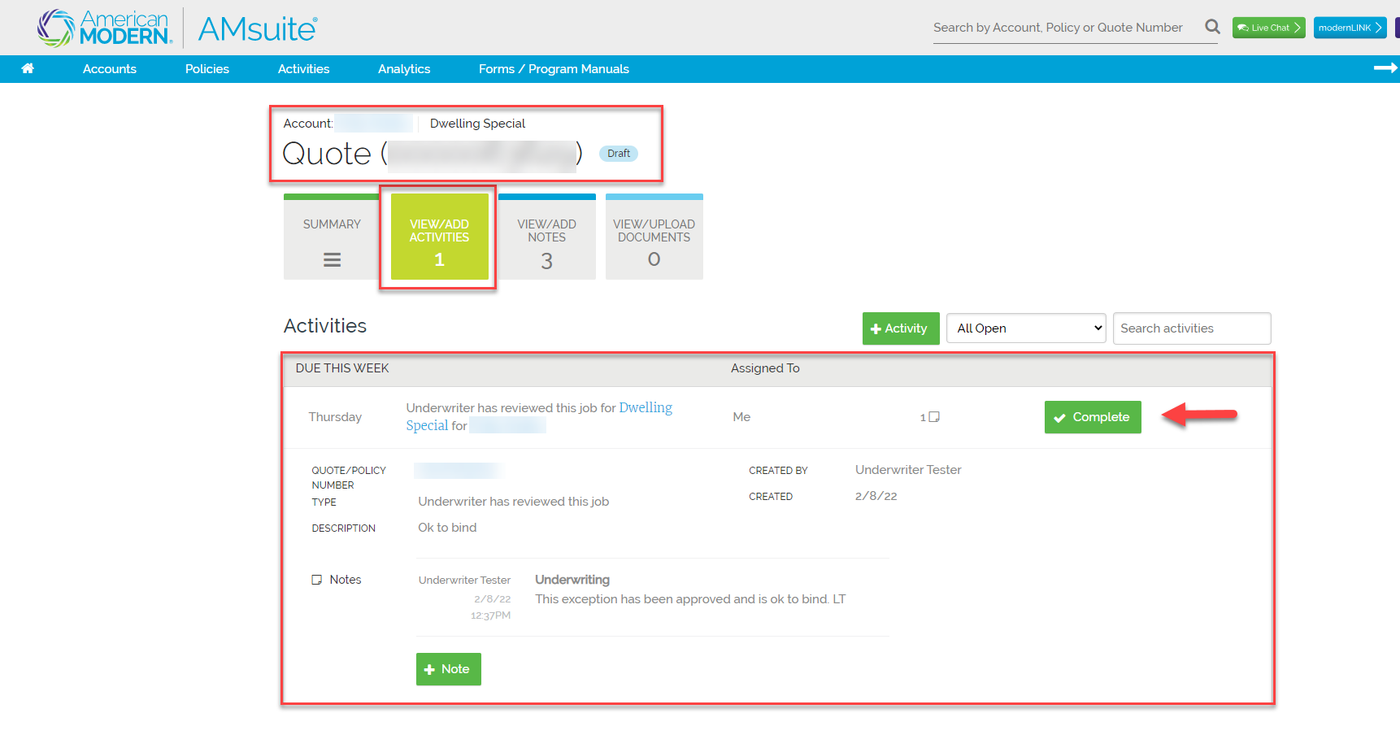
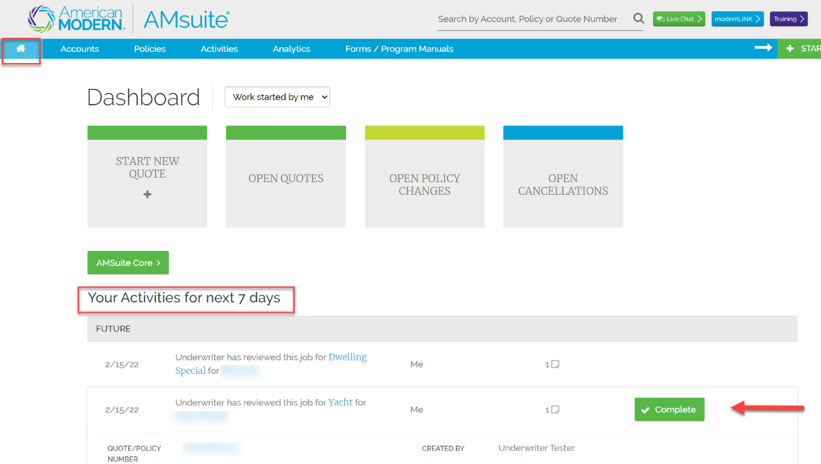
Underwriting Referral Process
11
To Complete the Activity and remove from the list, select
Complete from within the Activity or from the Home Page
list of Activities, select Complete
For Agent Use Only - Not for Distribution .
September 2024
Version: #2

Slide 7
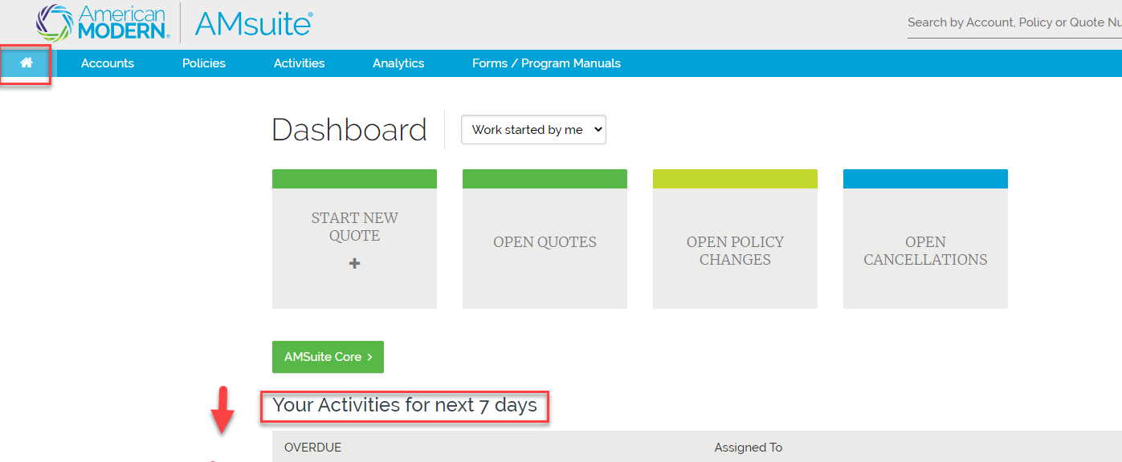
Viewing Activities
The Activities can be viewed in different ways. The following pages will show you how to view and complete Activities.
Viewing Activities from the Dashboard
1
From the Home Page of AMsuite, view Activites by scrolling down the screen
Activites will be in due date order, select the plus + symbol to open the Activity
2
For Agent Use Only - Not for Distribution .
September 2024
Version: #2

Slide 8
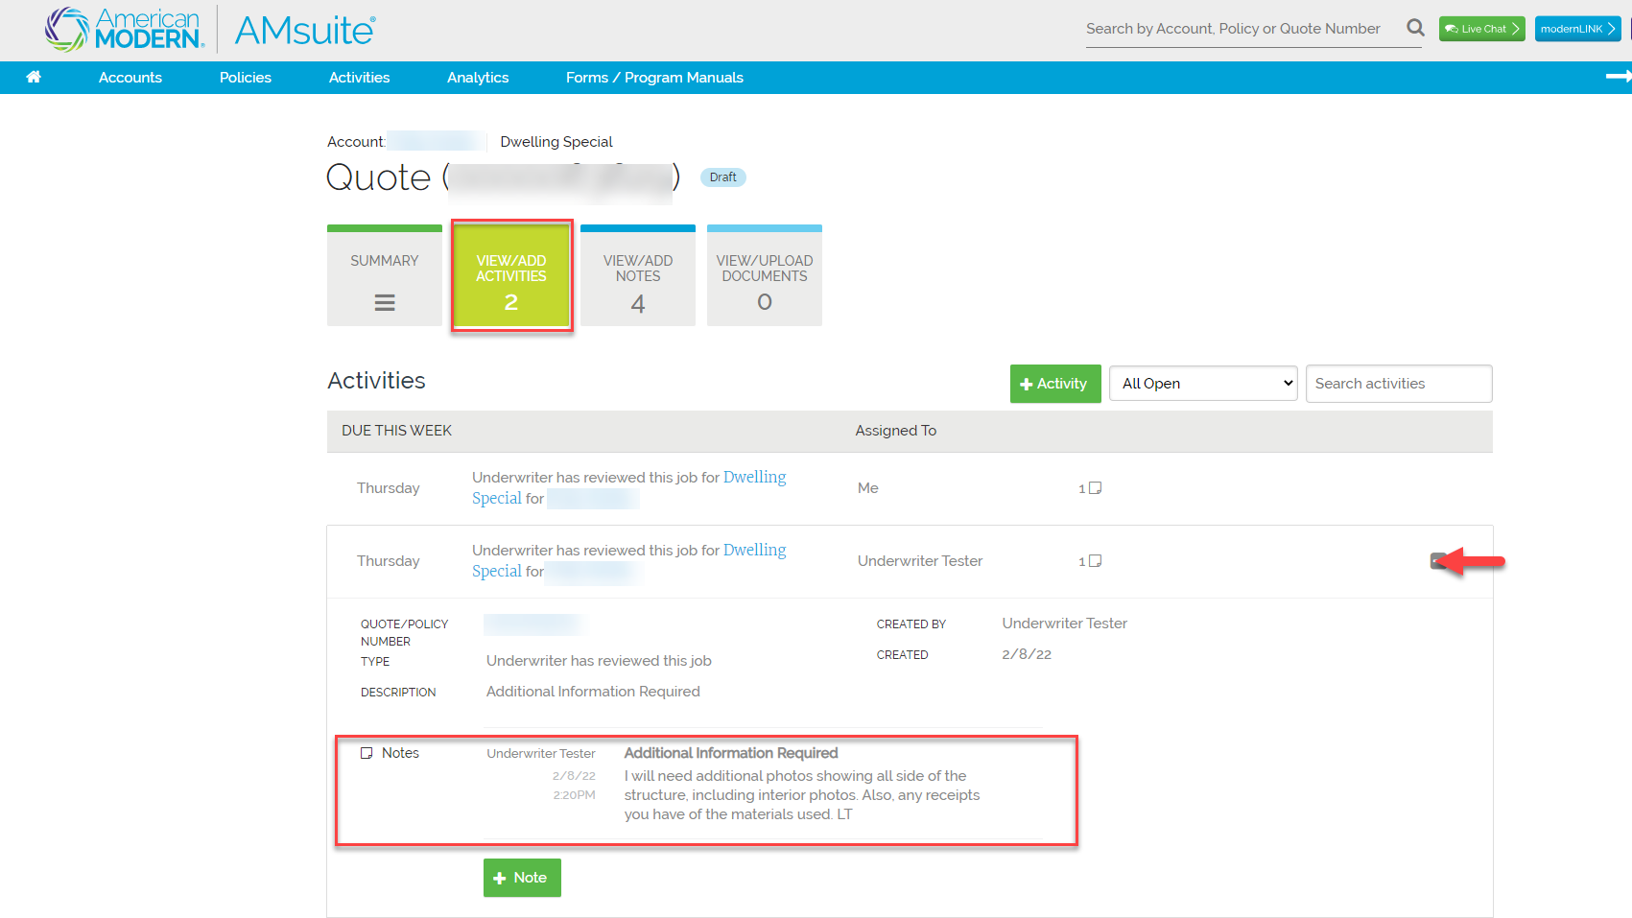
Viewing Activities
Viewing Activities from within a policy or quote
Activities can also be viewed from within the policy or quote by selecting the View/Add Activities Tile
The Activities will display on the screen
Select the plus + symbol to expand the activity to read or add a note
If you need to create an Activity, select the green Activity Tile.
3
For Agent Use Only - Not for Distribution .
September 2024
Version: #2

Slide 9
Viewing Activities
4
To Complete the Activity and remove from the list, select
Complete from within the Activity or from the Home Page
list of Activities, select Complete
For Agent Use Only - Not for Distribution .
February 2022
Version: #1

Slide 10
Viewing Activities
Helpful Hints
When quoting, if you receive a message that your quote requires Underwriting Review
Edit quote to make it eligible or
Submit the quote to your Underwriting Authority for further review via an Activity
The Underwriter reviews the quote, the exception request, and will either approve or decline the request for an exception.
The Underwriter may request additional information with the decline to review further
The Underwriter will respond through an Activity within five business days after submission (8 PM EST)
An email notification will be sent advising of an Activity
View the Activity if approved, complete the quote or policy change
Mark the Activity Complete to remove from your list of Activities
For Agent Use Only - Not for Distribution
Coverage is subject to policy terms, conditions, limitations, exclusions, underwriting review and approval, and may not be available for all risks or in all states. Rates and discounts vary, are determined by many factors and are subject to change. Policies are written by one of the licensed insurers of American Modern Insurance Group, Inc., including but not limited to American Modern Property and Casualty Insurance Company (CA Lic. No. 6129-1). American Modern Insurance Group, American Modern, AMsuite, and Homeowners FLEX are registered trademarks of American Modern Insurance Group, Inc. ©2024. American Modern Insurance Group, Inc., 7000 Midland Blvd. Cincinnati, OH, 45102-2607, USA. All rights reserved.
September 2024
Version: #2

